Slide 1
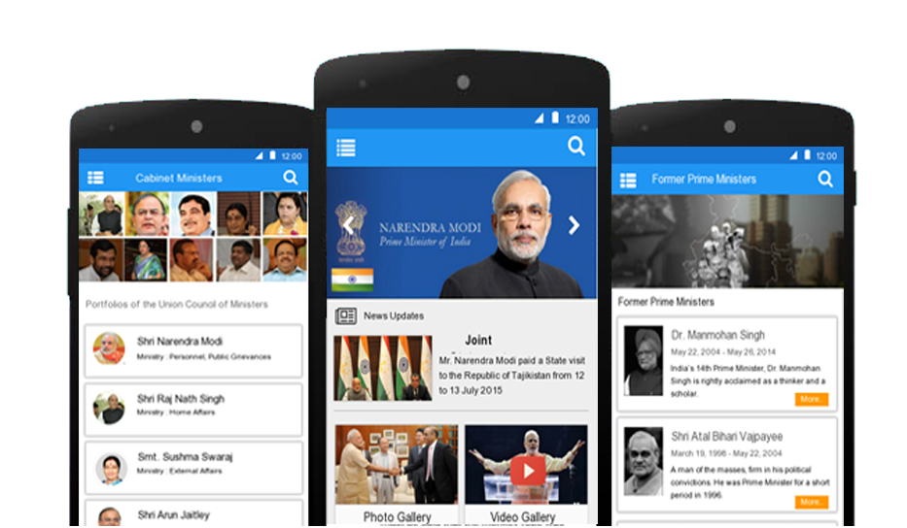
PMO Mobile APP
CODE CHASERS

Slide 2
AGENDA
Overview of WireFrames
Unique Features of the Wireframe
Wireframes
System Diagram
Deployment Architecture
Server Stack
Scalability
Performance
Power Management
Accessibility
Security
Skills set of the team members

Slide 3
Overview of Wireframes

Slide 4
It was designed by conforming to the guidelines of Material Design.
Consistency was the core principle of the design
Usability of every component was thoughtfully considered
Conforming to the blueprint

Slide 5
Unique Features

Slide 6
Ease of Access, use of minimum button press to perform a task
Consistent and adaptive design
Inbuilt social interaction(Comments) in every component
Bold and Bright colours as per the design guidelines
The transformation and animation create meaning
Ever accessible search button, which can search through the entire app
FAB becomes available when an action is required in a page
Use of keyline

Slide 7
Wireframes

Slide 8
Log in and Sign Up

Slide 9
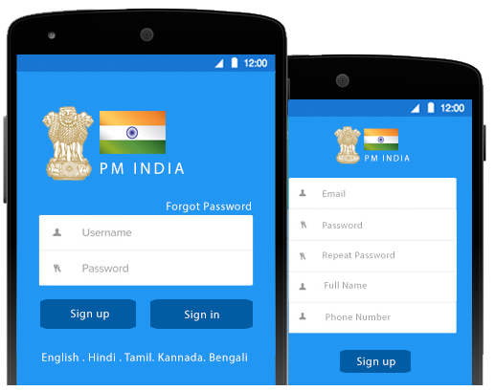

Slide 10
Home Page

Slide 11
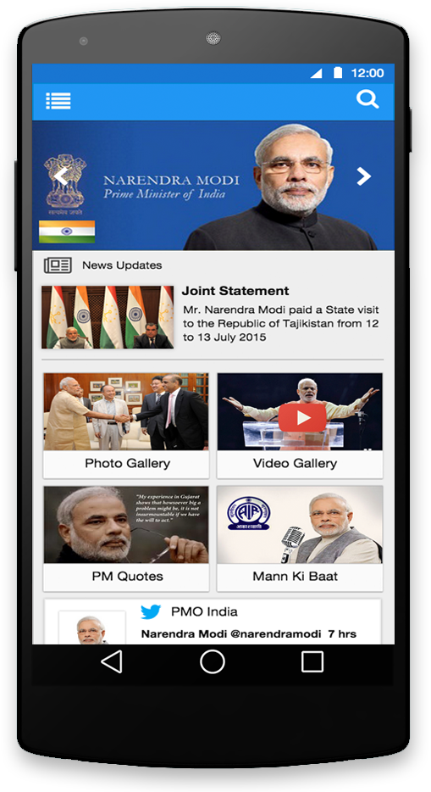

Slide 12
Navigation Drawer

Slide 13
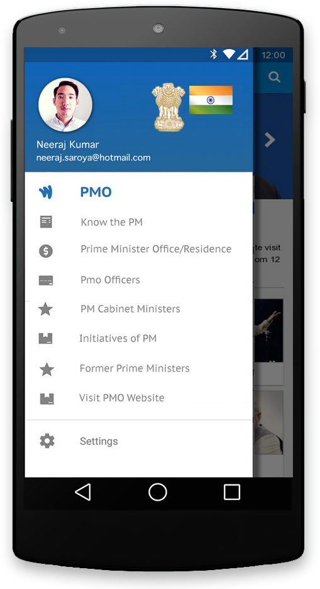

Slide 14
News Feeds

Slide 15
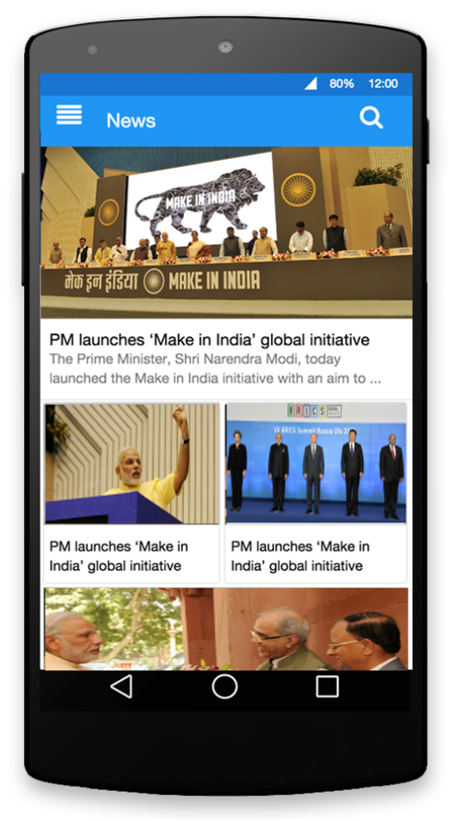
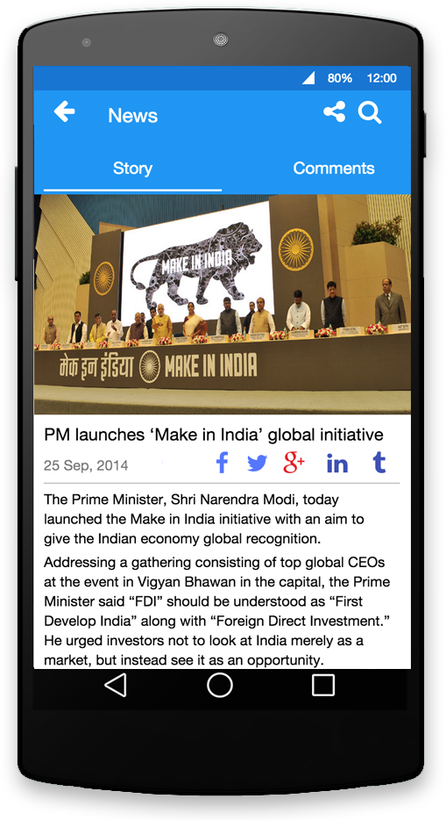
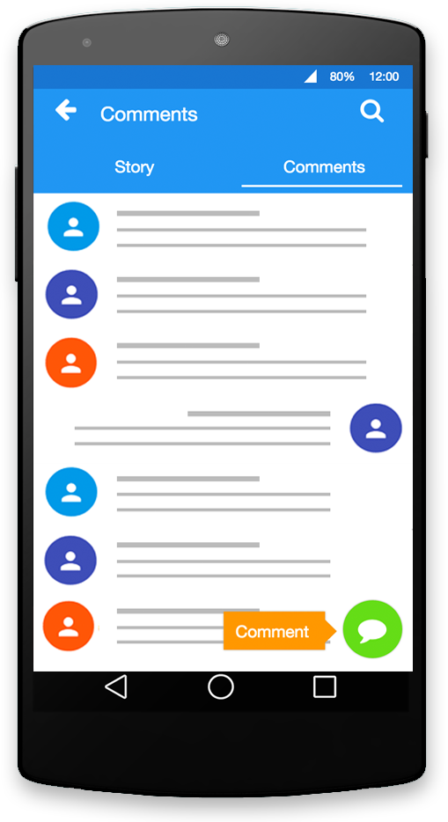

Slide 16
Store

Slide 17
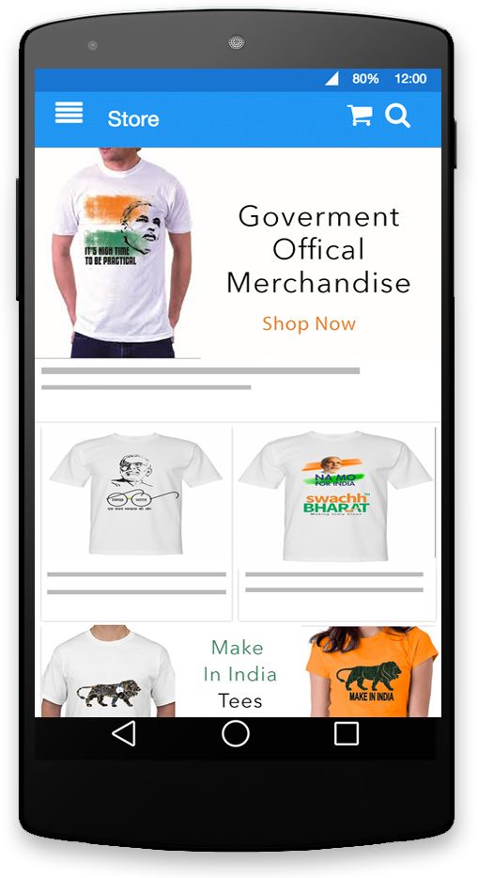
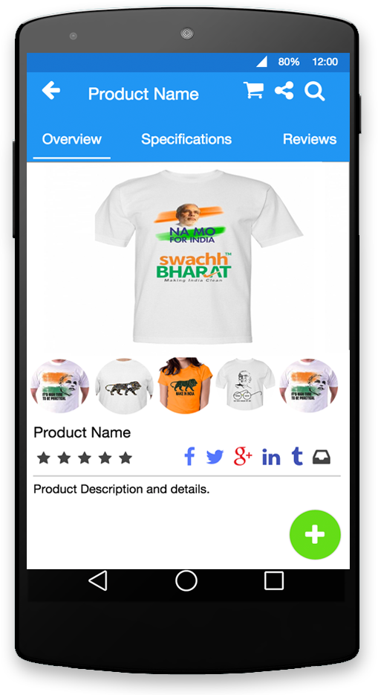
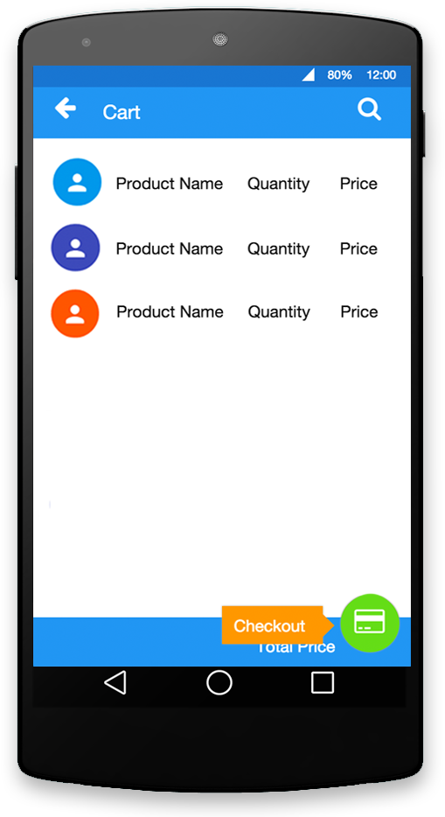

Slide 18
Notifications

Slide 19
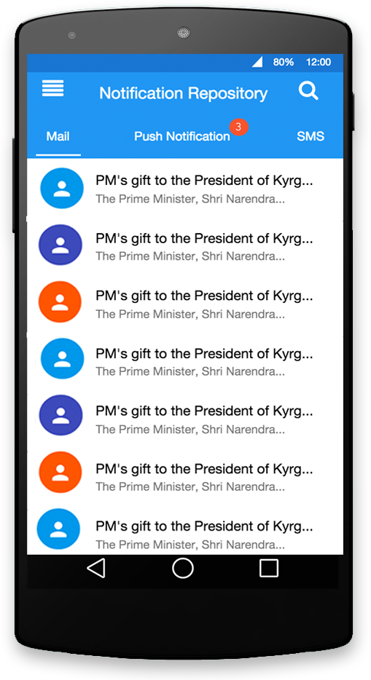
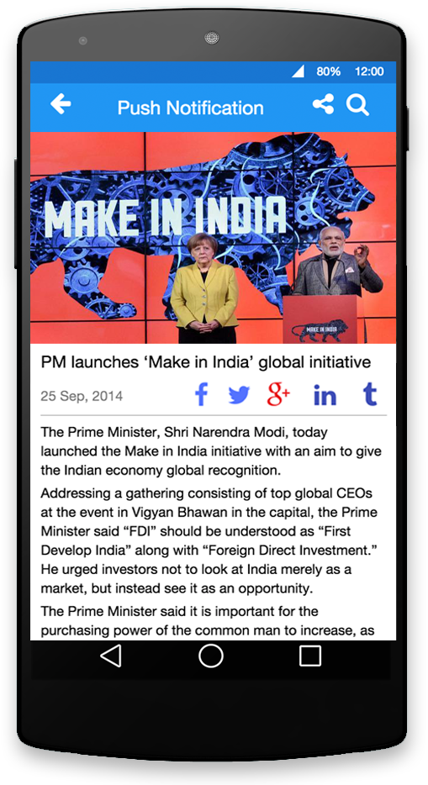

Slide 20
Photo-Video Gallery

Slide 21
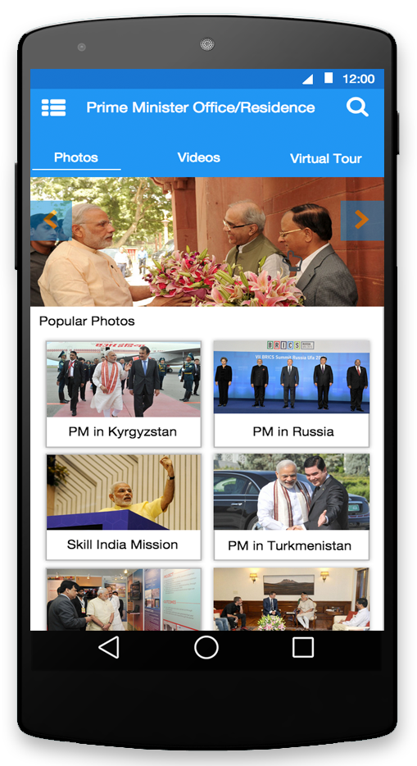
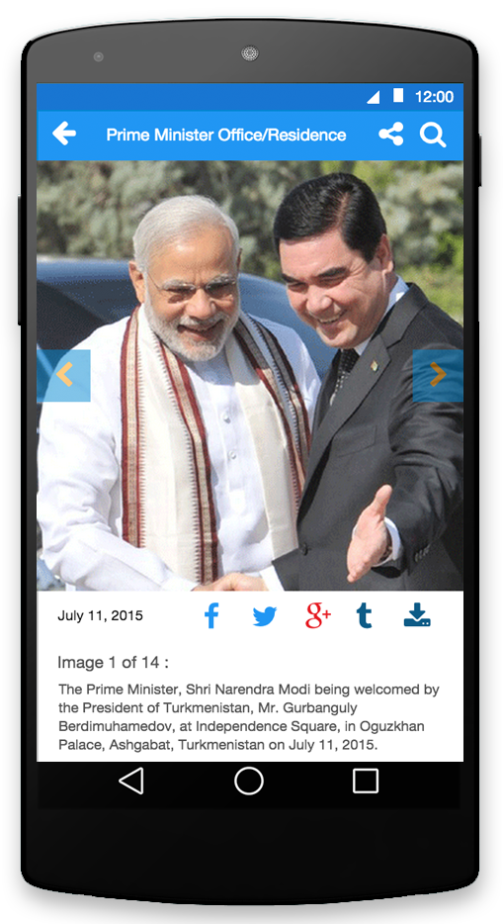

Slide 22
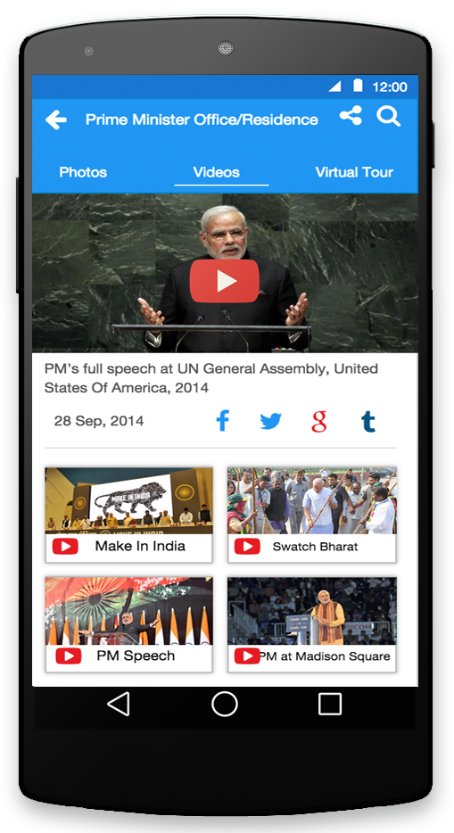
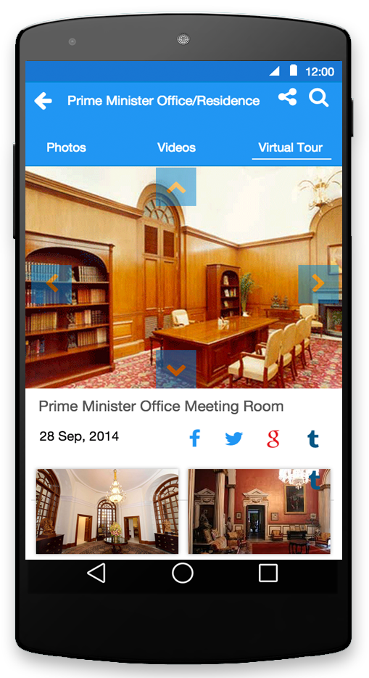

Slide 23
Donate

Slide 24
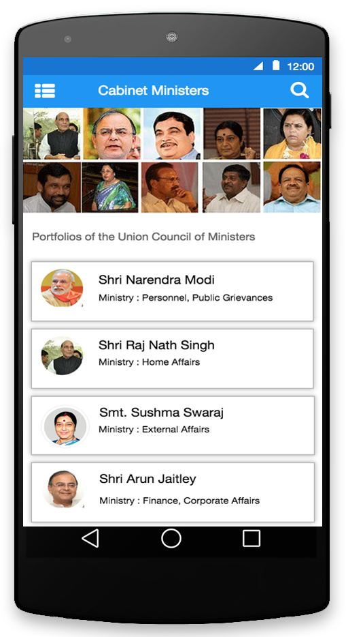
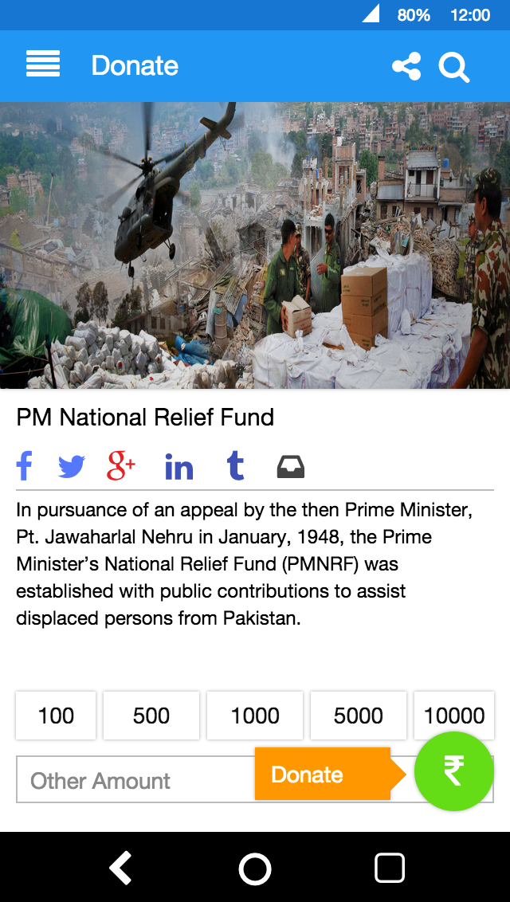
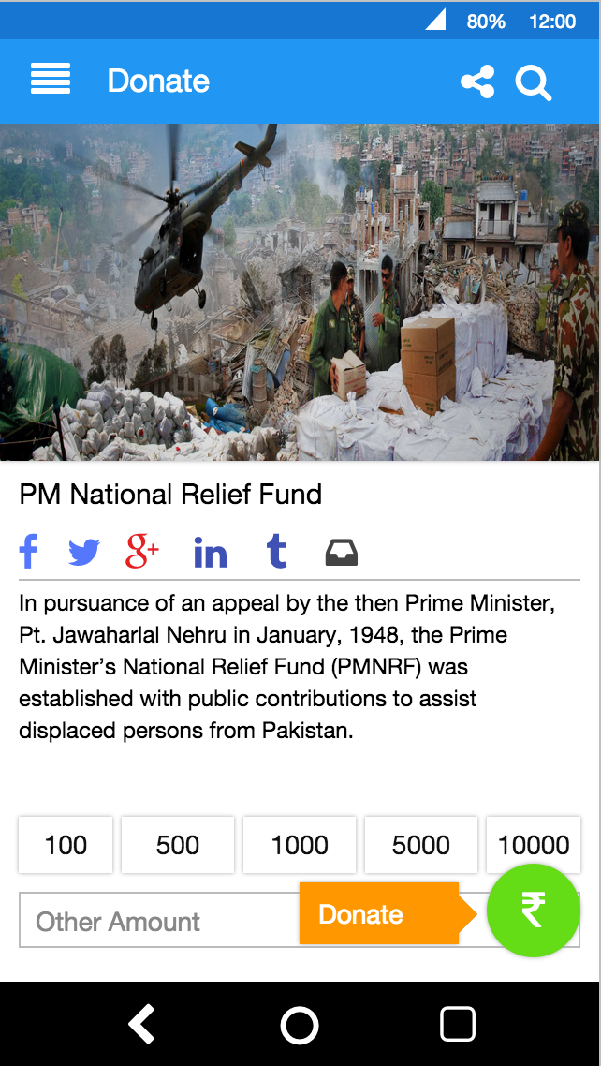

Slide 25
Write To PM

Slide 26
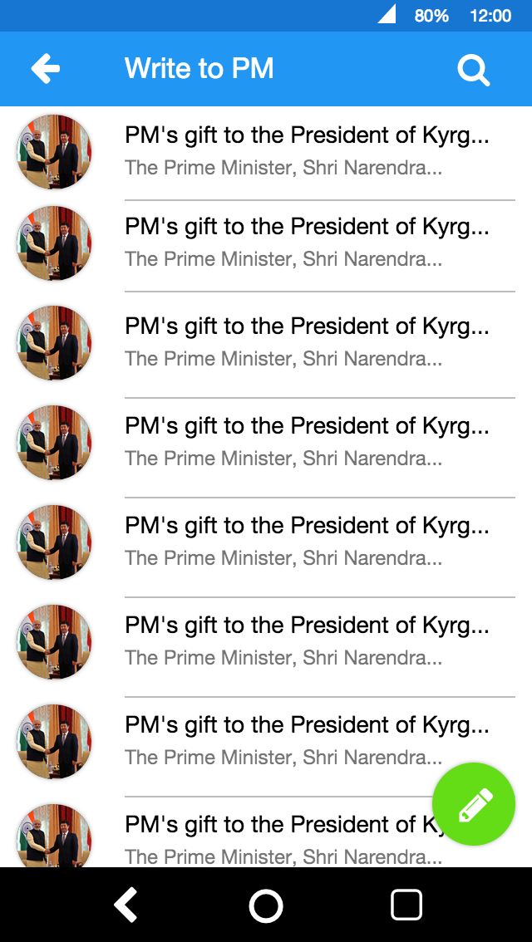
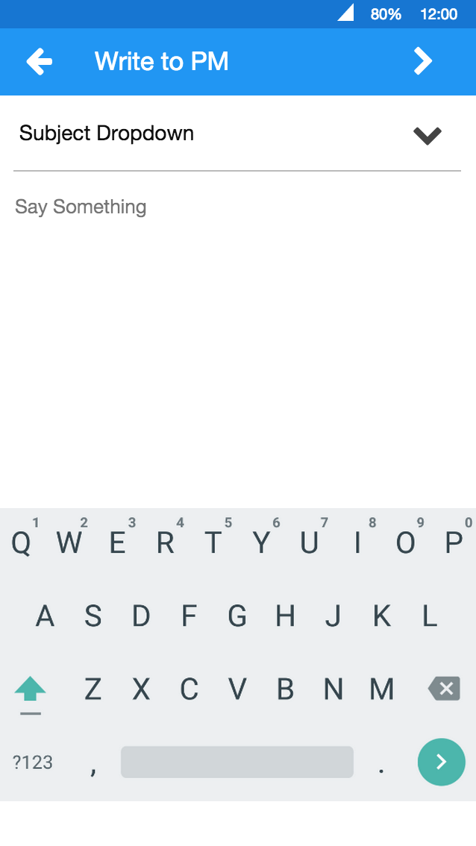

Slide 27
Search

Slide 28
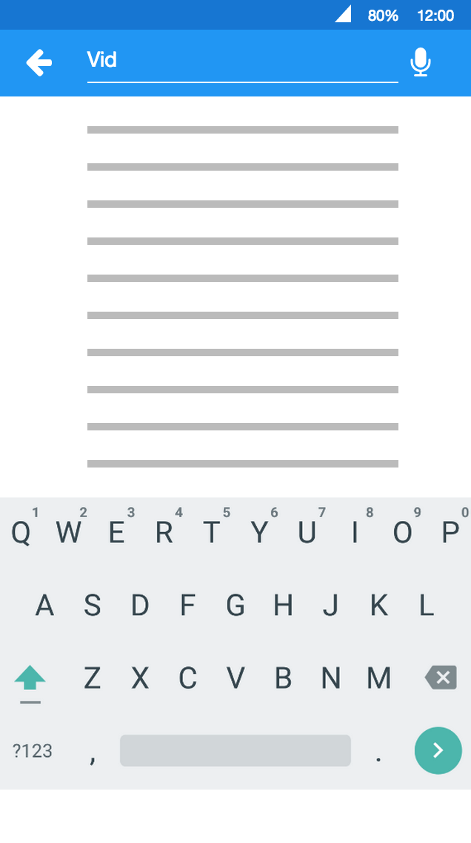
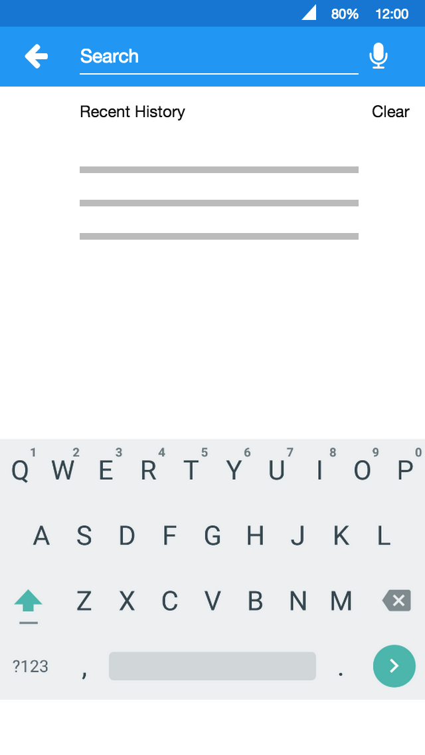

Slide 29
System Diagram

Slide 30
GPS
Android OS
Google Cloud Platform
Internet
PMO App
Https
PMO BackEnd
PMOMainComponent
PMOBackendComponent
PMONotificationComponent
JSON

Slide 31
Deployment Architecture

Slide 32
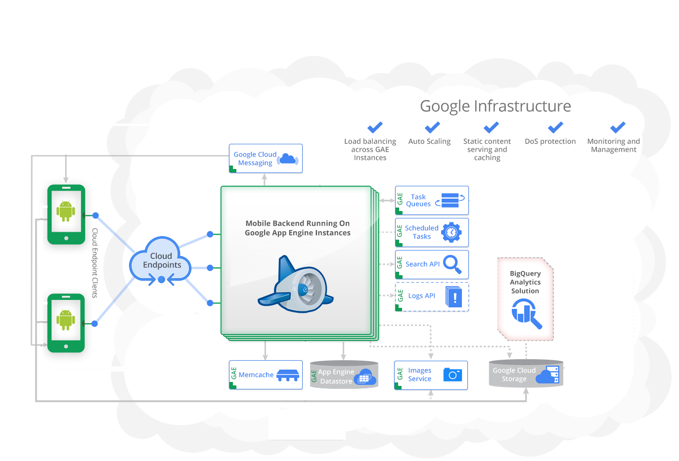

Slide 33

App Engine
PMOAppBackEnd.war
WEB-INF
src folder
appengine-web.xml
web.xml

Slide 34
Benefits of Google Cloud Platform
Automatic Scalability
Automatic Load balancing
Static Content Serving and caching(Memcache)
Reliability and Performance
Monitoring and management
Configurable DoS protection

Slide 35
Server Stack

Slide 36
Google App Engine
Google Cloud Storage
Google Cloud Messaging
Google Cloud Endpoints
Java
Android SDK
Gradle
Git

Slide 37
Scalability

Slide 38
Scalability of the backend server is insured by using Google Cloud Platform services(App Engine and related).
Scalability in the code is insured by the effective use of design patterns and the use of OOP features.
The design of the screens will be responsive and adaptive to ensure scalability in different devices.

Slide 39
Performance

Slide 40
Use of tried and tested efficient programming practices, existing API’s etc.
Reducing Overdraw.
Using effective threading to minimise the load on UI Thread.
Caching the data locally to make the app available even when there is no connectivity.
Managing data transfer with SyncAdapters.
Using performance tools like Android Lint and TraceView to identify bottlenecks and performance leaks in app.
Optimising Memory usage with the help of tools like Memory monitor.

Slide 41
Power Management

Slide 42
Whenever possible delegating network jobs to the Android Job Scheduler API for optimisation.
Effectively using WakeLocks for performing tasks.
Using Tools like Battery Historian to identify the reasons of power drain.

Slide 43
Accessibility

Slide 44
Localising app to support different languages.
Content description will be provided for UI components that don’t have visible text.
Focus based navigation will be enabled.
Audio feedback will always have a secondary feedback mechanism like a text message.

Slide 45
Security

Slide 46
Inbuilt DoS protection from App engine
Using the secure App Engine authentication API for login
Use some other SDKs for login like Facebook, twitter, Google+ etc.
Obfuscate the code (ProGuard)

Slide 47
Team Members and Skills

Slide 48

Neeraj Kumar Saroya
Full stack developer with 5 years of software development working experience. Currently working with Siemens as Design and Development Engineer.
Specialises in creative web design & development, java based websites and android app development.
Skill Set: JAVA, J2EE, Android, Spring MVC, Hibernate , jQuery, HTML5, CSS, JavaScript, AJAX, MySql, Adobe Photoshop CS5, Adobe Dreamweaver CS5, Adobe Flash CS5

Slide 49

Aditya Agrawal
Engineering graduate with a 5 years of software development experience in various domain. Currently working with Siemens as Design and Development Engineer.
Specialisation includes Java and android application development along with database.
Skill Set: JAVA, J2EE, Android, HTML,CSS, MySql

Slide 50
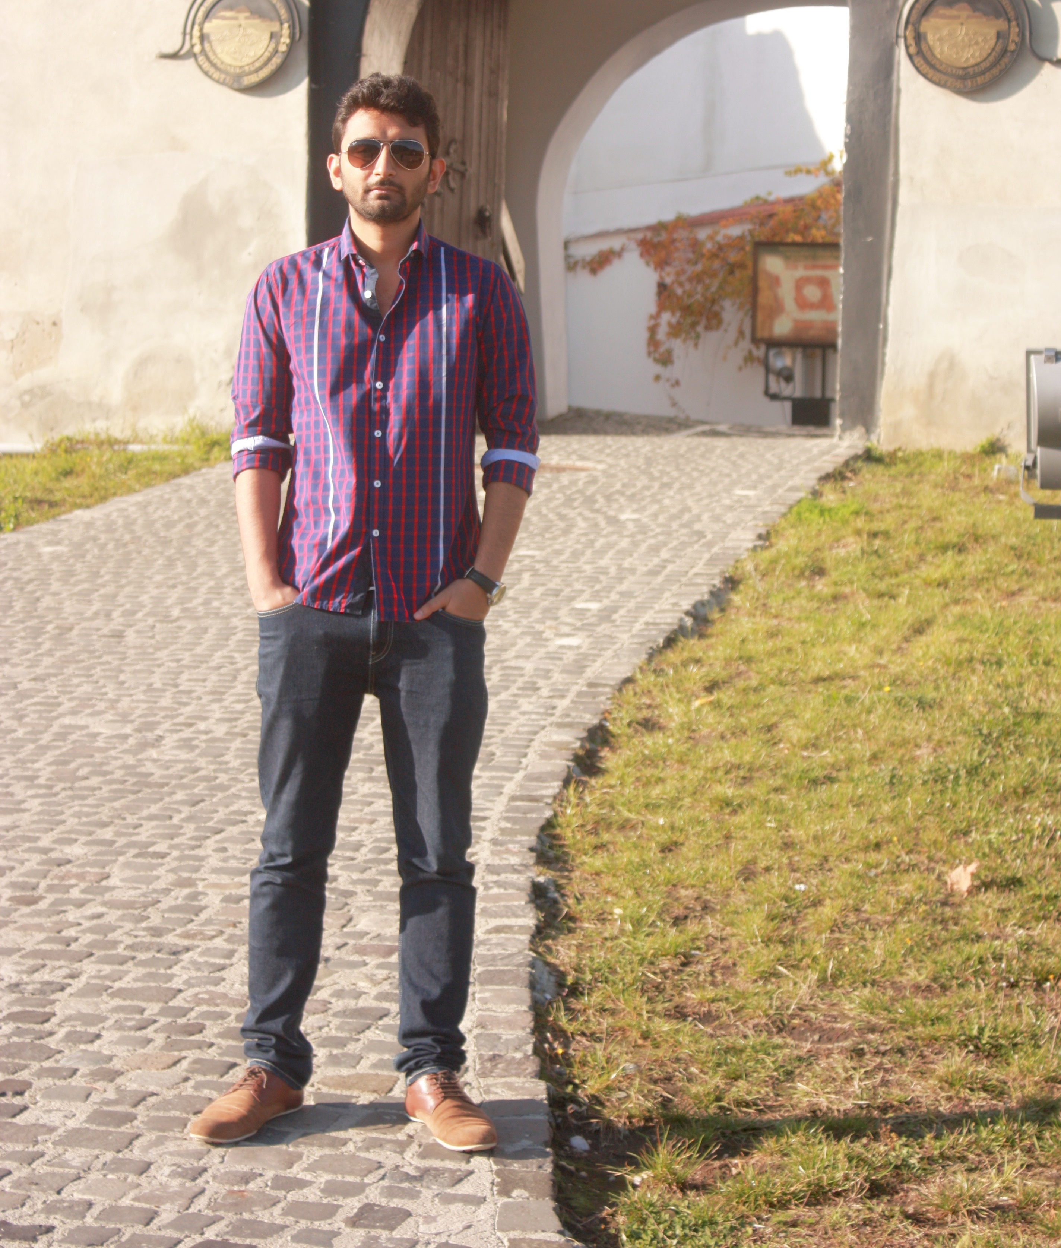
Chetan Melkani
A full stack developer with 4+ years of developing applications and products in Java and J2EE. Currently working with Siemens as Design and Development Engineer.
Have worked on complex web applications in Finance and Energy domain.
Has open source android projects in GitHub.
Active participation in Hackathons and online coding competitions.
Skill Set: Java, J2EE, Android, Spring, Hibernate, JavaScript, jQuery, HTML, CSS, HTML, MySql, Oracle, Maven, Jenkins.

